Slide 2
Journaling?
Why is it needed?
How does file system journaling work?
Ordered, writeback, and data journaling in ext3/4?
What is the problem with writeback?
What is the problem with data mode?
Notes:
Does this show?

Slide 3

Why Journaling?
Purpose:
Crash consistency for update-in-place file systems
Update-in-place can give logical locality more easily than CoW file systems
Achieve atomic updates despite crashes
Turns multiple writes into single atomic action

Slide 4
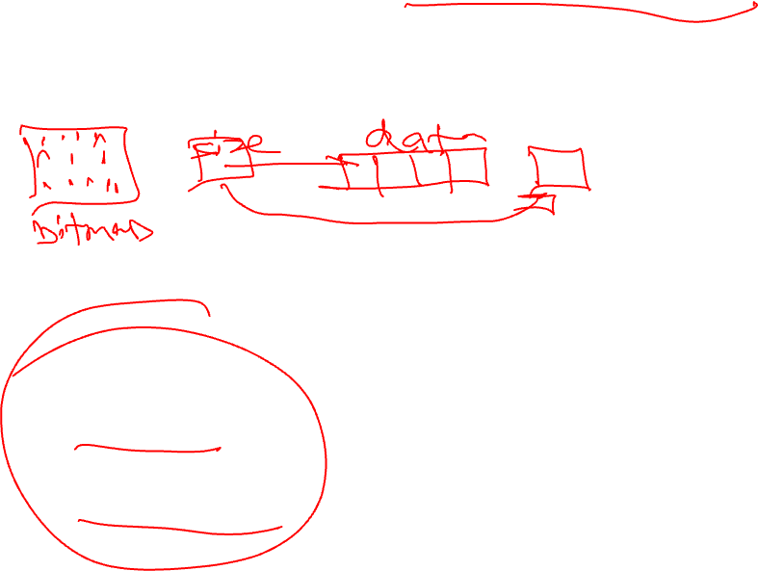
Example: File Append
Workload: Appends block to single file
Must update file-system structures atomically
Bitmap Mark new block as allocated
Inode Point to new block
Data block Contain data of append

Slide 5

Journaling: High-Level Overview
Intuition
Before updating file system, write note describing update
Make sure note is safely on disk
Once note is safe, update file system
If interrupted, read note and redo updates
Protocol
Write the data (no pointers to it) - Optional
Write the note: Journal Metadata
Make sure the note is durably written: Journal Commit
Update the in-place metadata: Checkpointing
Replay the note: Recovery
Notes:
At a high level, journaling works as follows:
Before updating the file-system in place, we first write a note describing the update.
We make sure the note is safely on disk.
We then go ahead and update the file system in place.
If we are interrupted by a crash, we can just read the note again and redo the updates.
This ensures the update is performed in its entirety, ensuring consistency.

Slide 6
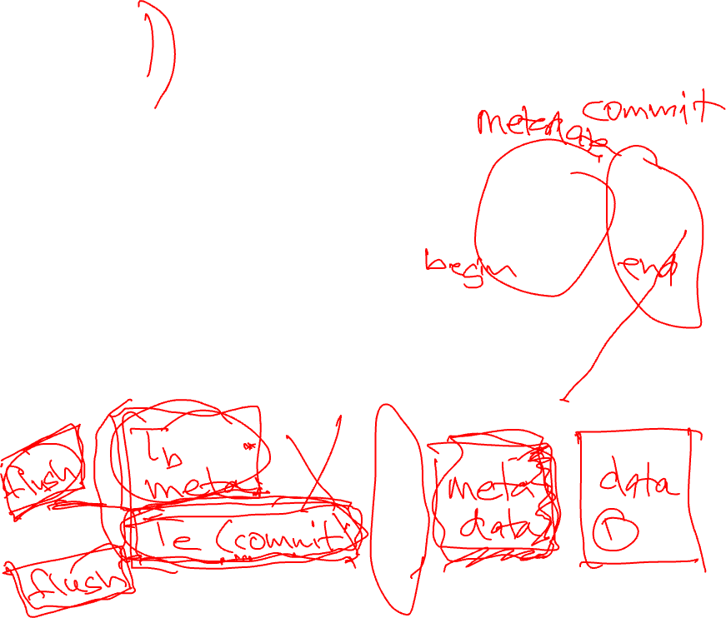
Ordered Journaling
Protocol: Append of data block Data
Tb
inode
data
Tb
inode
T
e
inode
bit map
bit map
bit map
T
e
data
Memory
Disk
Journal (Log)
File System Proper

Slide 7
Ordered Journaling
Protocol: Append of data block Data
Transaction Begin + Metadata
Tb
inode
data
Tb
inode
T
e
inode
bit map
bit map
bit map
T
e
data
Wait; Transaction Commit
Wait; Checkpoint inode, bitmap
Memory
Disk
Journal (Log)
File System Proper

Slide 8
Writeback Journaling
Protocol: Append of data block Doesn’t guarantee data written before transation of metadata
Tb
inode
data
Tb
inode
T
e
inode
bit map
bit map
bit map
T
e
data
Memory
Disk
Journal (Log)
File System Proper

Slide 9
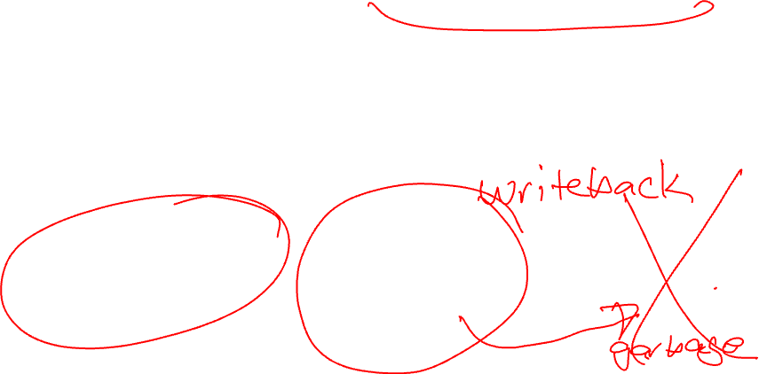
Writeback Journaling
Protocol: Append of data block Doesn’t guarantee data written before transation of metadata
Problems if crash before data?
Tb
inode
data
Tb
inode
T
e
inode
bit map
bit map
bit map
T
e
data
Memory
Disk
Journal (Log)
File System Proper

Slide 10
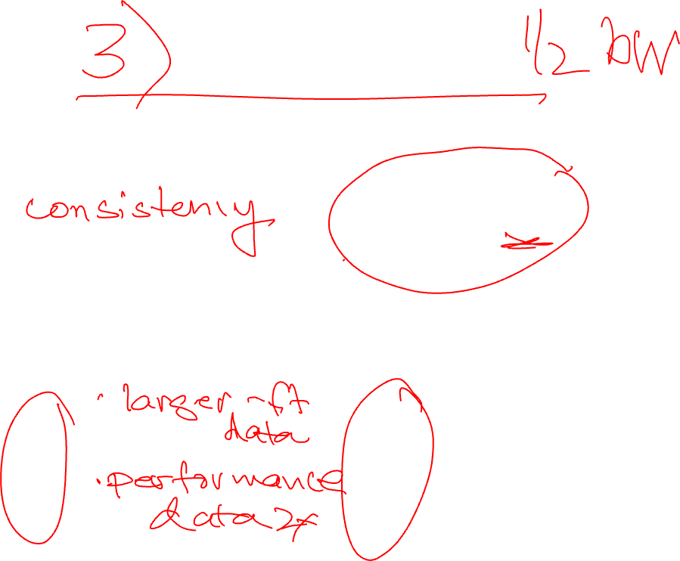
Data Journaling
Protocol: Append of data block
Tb
inode
Tb
inode
inode
bit map
bit map
bit map
data
T
e
Memory
Disk
Journal (Log)
File System Proper

Slide 11
Data Journaling
Protocol: Append of data block
TBegin + Metadata + Data
Tb
inode
Tb
inode
inode
bit map
bit map
bit map
data
T
e
Wait; Transaction Commit
Wait; Checkpoint inode, bitmap, and data
Memory
Disk
Journal (Log)
File System Proper

Slide 12
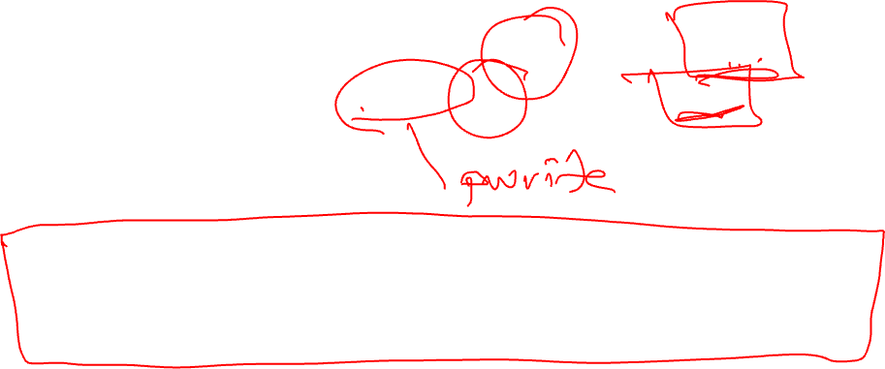
Question 2
Imagine you have some initial state (/x/f1 contains “a foo”) and your application wants to pwrite(/x/f1, 2 (offset), “bar”) so that the only two possible final states are “a foo” or “a bar” even if a crash occurs.
Assume each character represents one block.
What operations must your application do to be robust on all POSIX-compliant file systems?

Slide 13


Slide 14
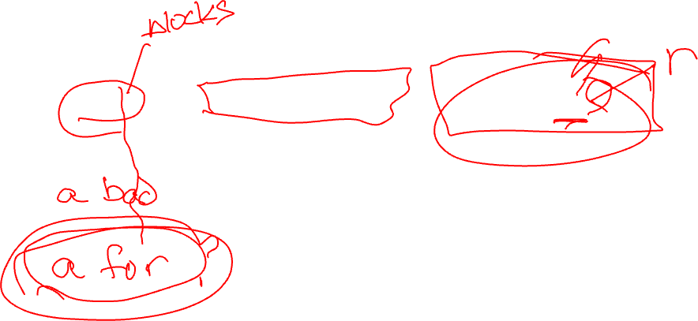
What are some possible intermediate states if crash?

Slide 16
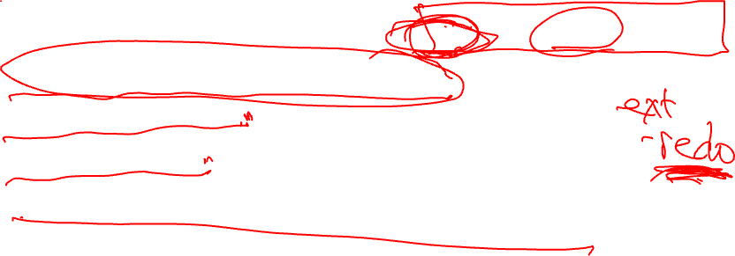

Slide 17


Slide 18
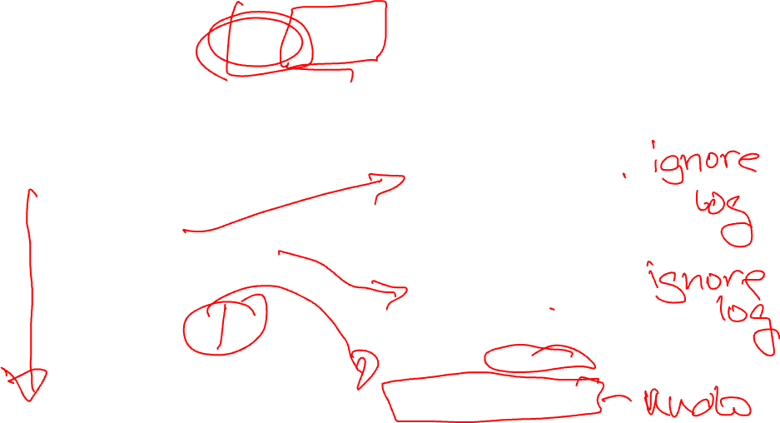
How to recover in each case?

Slide 21
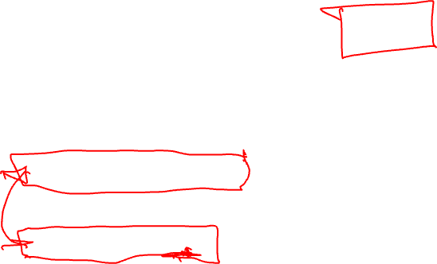
What can go wrong? What could be the resulting state?

Slide 22
Notes:
Data block containing bar can be flushed out before anything for log1

Slide 23


Slide 24


Slide 25

Solution?

Slide 27
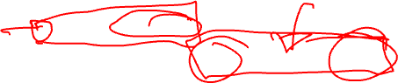

Slide 28
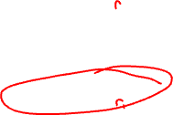

Slide 29


Slide 30

Question 3
What is the drawback of creating applications that work correctly on all file systems?

Slide 31
Question 4
What are persistence properties?
How can they be determined?

Slide 32


Slide 33
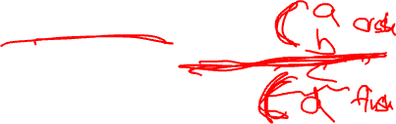

Slide 34
Question 5
What property is provided by all studied file systems?
What property is provided by none?
Which file system provides the fewest guarantees?
Which file system provides the most?
Table 1…

Slide 35
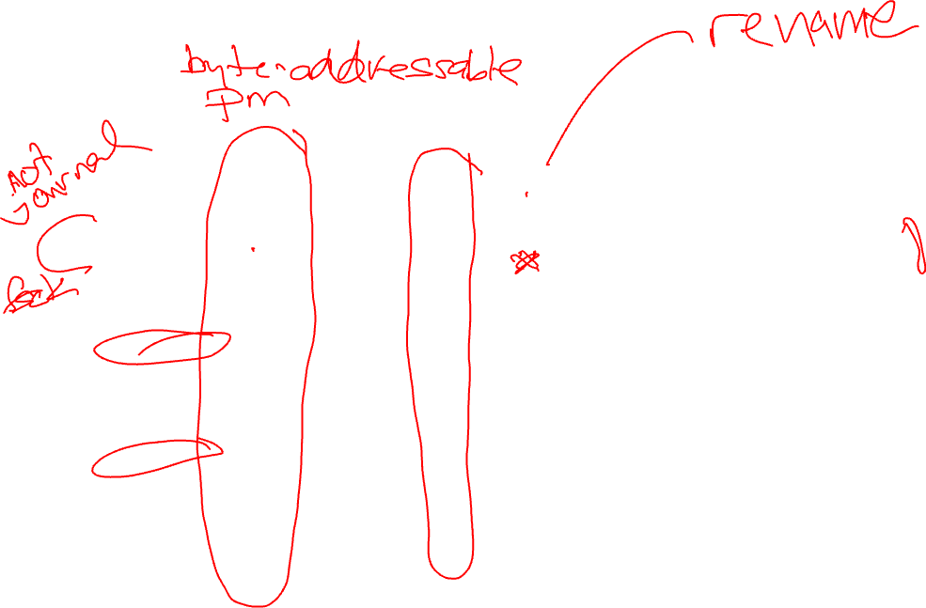

Slide 36
Question 6
What assumptions does the Git add protocol make about ordering and atomicity of the underlying file system?
Figure 4…

Slide 37

Notes:
Figure 4Gii – inlines Git store object and does first ops through first stdout

Slide 38
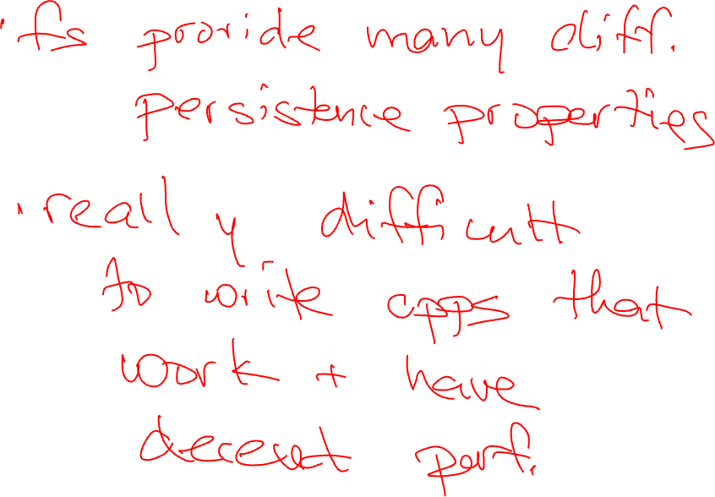
Conclusions?
Notes:
File systems provide different guarantees about state after a crash (persistent properties)
Applications are difficult to write such that correct on all file systems
Get worse performance when must add extra fsync operations

Slide 39


Optimistic
Crash Consistency
Vijay Chidambaram
Thanumalayan Sankaranarayana Pillai
Andrea Arpaci-Dusseau
Remzi Arpaci-Dusseau

Slide 40
Default Journaling is Pessimistic
Assume crash is going to happen
Do extra work during normal runtime
Maintain consistency using flushes
If crash does not happen, flushes are not actually needed

Slide 41
Flushing Performance Impact
Comparing FileBench Varmail performance
Throughput (Ops/s)
ext4 configuration
~ 5X performance difference based on flushing!

Slide 42
Probabilistic Crash Consistency
Practitioners turn off flushes due to performance degradation
E.g., ext3 by default did not enable flushes for many years
Observe crashes do not cause inconsistency for some workloads

Slide 43
Journaling with Flushes
Journaling protocol (ordered mode)
Data write (D)
Logging Metadata (JM)
Logging Commit (JC)
Checkpointing (M)
DATA
METADATA
APPLICATION
FILE SYSTEM
D
JM
JC
M
DISK CACHE
FLUSH
FLUSH
DISK PLATTER
Journal

Slide 44
Journaling without Ordering
Without flushes, blocks may be reordered
E.g., JC and JM written first as disk head near journal
DATA
METADATA
APPLICATION
FILE SYSTEM
D
JM
JC
M
DISK CACHE
FLUSH
FLUSH
DISK PLATTER
Journal

Slide 45
Probabilistic Crash Consistency
Re-ordering leads to windows of vulnerability
MEMORY
D
JM
JC
M
Time
DISK (simulated)
JC
D
JM
M
Window
Total I/O Time
P-inconsistency = Time in window(s) / Total I/O Time

Slide 46
Types of Re-ordering
Correct Order
D
JM
JC
M
D
JC
JM
M
Early Commit
JC
D
JM
M
D
JM
M
JC
Early Checkpoint
D
M
JM
JC
M
D
JM
JC
Transaction Misorder
JCi
JCi-1
Notes:
Early commit: Jc looks good, so will play a bogus transaction without valud Jm
Early checkpoint: If crash while in the middle of checkpointing M, will mess up M, but won’t know that you can replay Jm and get a valid M

Slide 47
Results
P-inconsistency
Workloads
Nature of writes affects p-inconsistency

Slide 48
Probabilistic Crash Consistency
p-inconsistency for different workloads:
Read-heavy workloads have low p-inconsistency
Database workloads have high p-inconsistency
Turning off flushing provides performance, but does not ensure consistency
Additional techniques required to obtain both performance and consistency

Slide 49
Optimistic File System
Achieves both performance and consistency by trading on new axis
Freshness indicates how up-to-date state is after a crash
OptFS provides strong consistency while trading freshness for increased performance
X
State 1
State 2
State 3
State 4
OptFS
ext4
Notes:
Key idea of OptFS

Slide 50
Optimistic File System
Eliminates flushes in the common case
Blocks may be re-ordered without flushes
Optimistic Crash Consistency handles re-orderings with different techniques
Some re-orderings are detected after crash
Some re-orderings are prevented from occurring

Slide 51
Modified Disk Interface
Asynchronous Durability Notifications (ADN) signal when block is made durable
A
B
Disk
Cache
Disk
Platter

Slide 52
Modified Disk Interface
Asynchronous Durability Notifications (ADN) signal when block is made durable
A
B
Disk
Cache
A
B
Disk
Platter

Slide 53
Modified Disk Interface
ADNs increase disk freedom
Blocks can be destaged in any order
Blocks can be destaged at any time
Only requirement is to inform upper layer
OptFS uses ADNs to control what blocks are dirty at the same time in disk cache
Re-ordering can only happen among these blocks

Slide 54
Handling Re-Ordering: Removing Flush #1
Flush after JM is removed
Checksums used to handle reordering
DATA
METADATA
APPLICATION
FILE SYSTEM
D
JM
JC
M
DISK CACHE
FLUSH
FLUSH
DISK PLATTER
Journal

Slide 55
Technique #1: Checksums
JC could be re-ordered before D or JM
D
JM
FLUSH
JC
FLUSH
M
Re-ordering detected using checksums
Computed over data and metadata
Checked during recovery
Mismatch indicates blocks were lost during crash

Slide 56
Technique #1: Checksums
JC could be re-ordered before D or JM
D
JM
FLUSH
JC
FLUSH
M
Re-ordering detected using checksums
Computed over data and metadata
Checked during recovery
Mismatch indicates blocks were lost during crash

Slide 57
Technique #2: Delayed Writes
Wait until Jc written before updating metadata
DATA
METADATA
APPLICATION
FILE SYSTEM
D
JM
JC
M
DISK CACHE
FLUSH
D
FLUSH
JM
JC
DISK PLATTER
Journal

Slide 58
Can you explain why:
M:1 cannot be written? What could happen if it were written and crashed? If M:1 is not written and crash, what will recovery do?
Assume receive ADN for D:1. M:2 cannot be written? What could happen?
Assume receive ADN for D:1. M:3 cannot be written? What could happen?
Notes:
If checkpoint M:1 before D:1 is done, will point to bogus data; if crash what would happen during r

Slide 59
Optimistic Techniques
Other Techniques
In-order journal recovery and release
Reuse after notification
Selective data journaling
See paper for more details

Slide 60
File-system Primitives
fsync() provides ordering and durability
OptFS splits fsync()
osync() for only ordering and high performance
dsync() for durability
Primitives can increase performance
Ex: SQLite
write(log)
write(log)
fsync(log)
osync(log)
write(header)
write(header)
fsync(header)
dsync(header)

Slide 61
nosync, fsync and osync
create(f1, A)
create(f1, A)
create(f1, A)
fsync(f1)
osync(f1)
create(f2, B)
create(f2, B)
create(f2, B)
fsync(f2)
osync(f2)
create(f3, C)
create(f3, C)
create(f3, C)
X
X
X
fsync(f3)
osync(f3)
osync() ensures ordering and eventual durability

Slide 62
nosync, fsync and osync
create(f1, A)
create(f1, A)
create(f1, A)
fsync(f1)
osync(f1)
create(f2, B)
create(f2, B)
create(f2, B)
fsync(f2)
osync(f2)
create(f3, C)
create(f3, C)
create(f3, C)
X
X
X
fsync(f3)
osync(f3)
Possible states
Possible states
Possible states
(ɸ, ɸ, ɸ)
(A, ɸ, ɸ)
(A, B, ɸ)
(ɸ, ɸ, ɸ)
(ɸ, ɸ, C)
(ɸ, B, ɸ)
(A, B, C)
(A, ɸ, ɸ)
(ɸ, B, C)
(A, B, ɸ)
(A, ɸ, C)
(A, B, C)
(A, B, ɸ)
osync() ensures ordering and eventual durability
(A, B, C)

Slide 63
Performance
Due to OptFS journaling overwrites
OptFS handles data writeout better
Random writes becomes sequential
Due to OptFS journaling overwrites
OptFS handles data writeout better
Normalized performance
Workloads

Slide 64
Summary
Problem: provide both performance and consistency
Solution: decoupling ordering and durability in OptFS
Eventual Durability maintains consistency while trading freshness for increased performance
osync() - primitive to order application writes

